Slide 1

 | Shri Shivaji Vidya Prasarak Sanstha’s Bapusaheb Shivajirao Deore Polytechnic, Dhule Academic Year : 2023 – 2024 Department of Computer Engineering
A seminar on Capstone Project Proposal (CPP-22058)
Topic |  | Student Academic Progress Management
Presented by |  | 1.Badgujar Mohit Hemant
 |  | 2.Bhat Atharva Yogesh
 |  | 3.Deore Samarthya Ravindra
 |  | 4.Makhija Dhruv Harish
Guided by |  | Mr. C. P. Bhamare
Semester |  | 5 I | Date : 14 / 11 / 2023

Slide 2
Content
1. Abstract
2. Introduction and Background of the Industry
3. Literature Survey
3.1 Study of existing system / Review of Research Papers
3.2 Limitations of existing system / Problems discussed in research papers
3.3 Problem Identification /need of a system
3.4 Problem Definition
4. Specifications
4.1 User Requirements
4.2 System Requirements
5. Proposed Detailed Methodology of solving indentified problem
5.1 Proposed work
5.2 Proposed Design
6. Week wise Action Plan – for Sixth semester
7. References and Bibliography

Slide 3
1. Abstract
Educational institutions are facing challenges in managing student data, such as Attendance, Submissions(Assignments and Practical), class-test marks, Timetable and Submission Report. Manual data entry and processing can be time-consuming, error-prone, and inefficient.
We will design our website to address the administrative and data management needs of educational institutions. It computerize and automates student data management including Attendance, Submissions(Assignments and Practical), class-test marks, Timetable and Submission Report reducing manual workloads and errors.

Slide 4
2. Introduction
Attendance, Class-test Marks, Submission Report, Timetable, Assignments And Practical Submissions plays an important role to manage student record.
To manage and store these record manually is difficult, time consuming and causes lack of accuracy and data loss.
To overcome these problems, we aim to computerize all the student record and make it easy for college faculty to manage and keep backup of these data.
Where as for students, they can view there attendance, class-test marks, class wise timetable, submission report, assignments and practical submissions.

Slide 5
3. Literature Survey
3.1 Study of existing system / Review of Research Papers
Our college take attendance by calling roll no. and fills up the presenty in the muster table, which is time consuming.
Assignment details are managed by filling up the submission muster which may cause mistakes in it.
The marks of the conducted class test’s are filled up in the muster, which may consume time and is less efficient.
Recording the submission report is very time consuming and exhausting for student, because student has to gather the signature of faculty for approval.

Slide 6
3. Literature Survey
3.2 Limitations of existing system / Problems discussed in research papers
Lack of real-time attendance tracking, leading to potential inaccuracies and delays in updating attendance records.
Inefficiencies in handling timetable changes, such as manual adjustments or difficulties in accommodating conflicting schedules.
Challenges in tracking and managing the submission of assignments, including a lack of automated reminders or notifications for both students and faculty.

Slide 7
3. Literature Survey
3.3 Problem Identification /need of a system
Many Educational Institutions uses paper-sheets musters to keep records of students which makes it difficult and problematic to handle.
Keepings records of student in paper-sheets files with less accuracy resulting in misplaced of files, damaged files or even results in data loss. Such records are hard to retrieve, and are Time consuming. Also when in emergencies.
If there’s no security then any anonymous person can modify records.

Slide 8
3. Literature Survey
As manually keeping records of students Attendance, test marks, practical marks which are on papers, musters does not have any backups causes it to have big loss of data in any circumstances or disaster
To Overcome the problem of student data management regarding student attendance, Assignment & Practical submissions, class Test marks, Timetable.

Slide 9
3. Literature Survey
3.4 Problem Definition
In educational institutions, managing and maintaining student records is a complex and time-consuming task.
Some issues in Attendance like difficulties in managing student attendance, which may involve manual entry or reliance or outdated systems.
Challenges in efficiently recording and calculating student marks, as well as generating reports and transcripts.
Issues with creating and managing class schedules, including conflicts, changes, and ensuring proper allocation of resources, also the problems with handling and tracking the submission of assignments, projects, and other coursework.

Slide 10
4. Specification
4.1 User Requirements
View:
Attendance (Number of Lectures Attended)
Submissions (Assignments and Practical)
Syllabus
Timetable
Class Test Marks (1st and 2nd)

Slide 11
4. Specification
Feedback of teachers teaching and facilities provided to them
Submission Report (No dues)
Notes shared by teachers
Letter to HOD for personal or emergency reasons
Overall Report:
Total percentage of attendance
Marks obtained by student in Class Test 1 and 2
Submissions Report (No dues, Assignment, Practical)
Teachers Remark

Slide 12
4. Specification
4.2 System Requirements:
Operating System: Windows OS
RAM: 2 GB(Min)
Processor: Intel Core i3

Slide 13
5.1 Proposed work

Slide 14
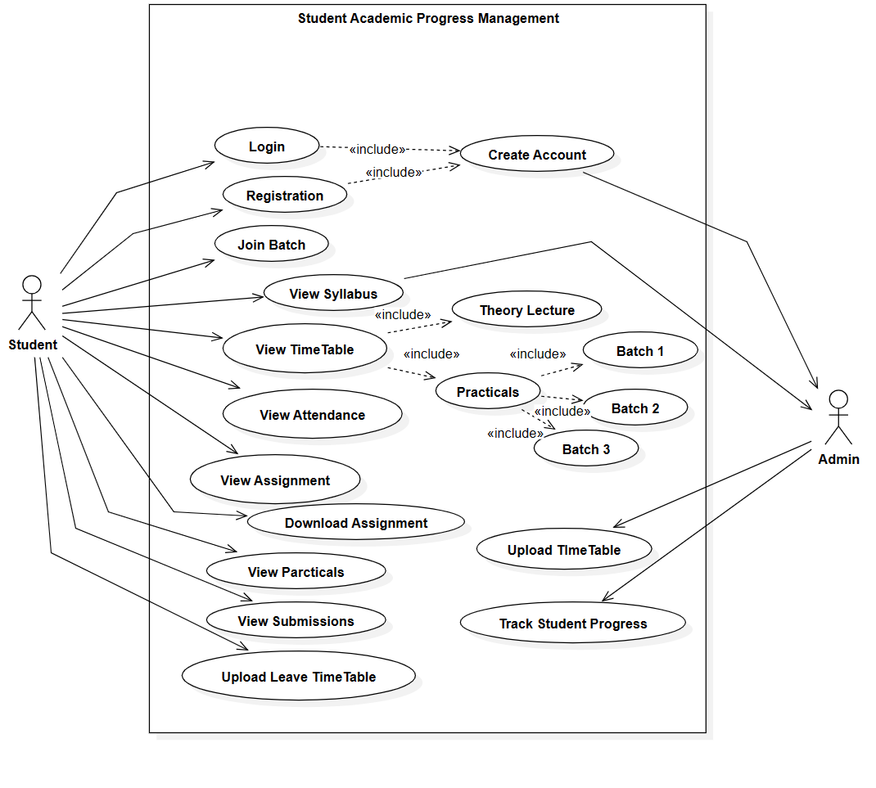
5.2 Proposed Design

Slide 15
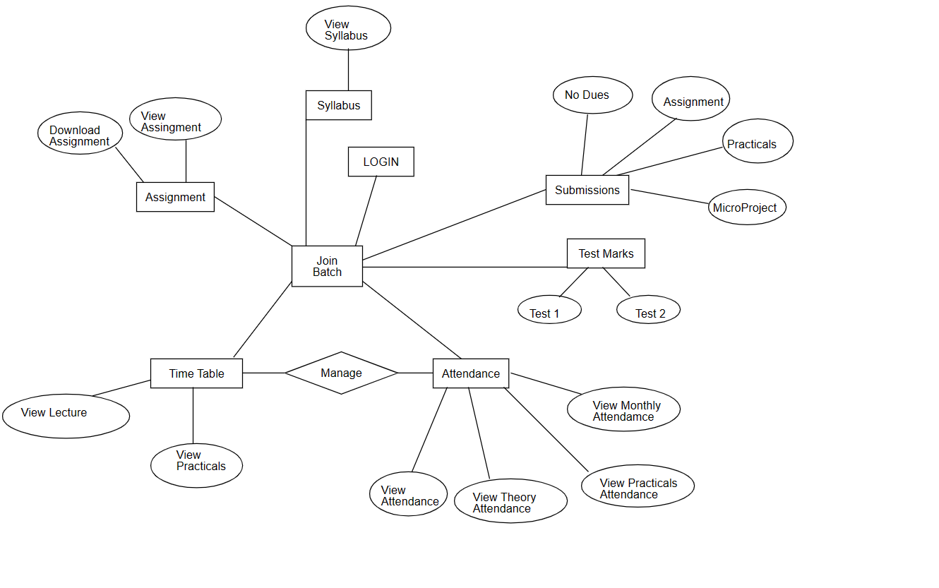
5.2 Proposed Design

Slide 16
6. Week wise Action Plan – for Sixth semester
Sr. No. | List of Activities | Week | Dates
1 | Design User Interface | Week 1 | 01/01/2024 to 06/01/2024
2 | Design database structure, create database | Week 2 | 07/01/2024 to 13/01/2024
3 | Develop GUI and various Interfaces | Week 3 | 14/01/2024 to 20/01/2024
4 | Programming / coding , database connectivity, if required | Week 4 | 21/01/2024 to 27/01/2024
 |  | Week 5 | 28/01/2024 to 03/02/2024
5 | Installation of Project, Dummy Data Entry | Week 6 | 04/02/2024 to 10/02/2024
6 | Testing | Week 7 | 11/02/2024 to 17/02/2024
7 | Modifications (if any required) | Week 8 | 18/02/2024 to 24/02/2024
8 | Project Report Writing | Week 9 | 25/02/2024 to 02/03/2024
9 | Submission of project report | Week 10 | 03/03/2024 to 09/03/2024

Slide 17
7. References and Bibliography
The Academic Portfolio System (APS) Usage Intention of Senior High ...
https://www.mdpi.com/2071-1050/13/15/8394
The Use of Student's Performance - ERIC https://files.eric.ed.gov/fulltext/ED504219.pdf-
GitHub Repository:-
https://docs.github.com/en/get-started/quickstart/create-a-repo

Slide 18
Thank You!!

